Slide 1
Applications Of NLP

Slide 2


Slide 3
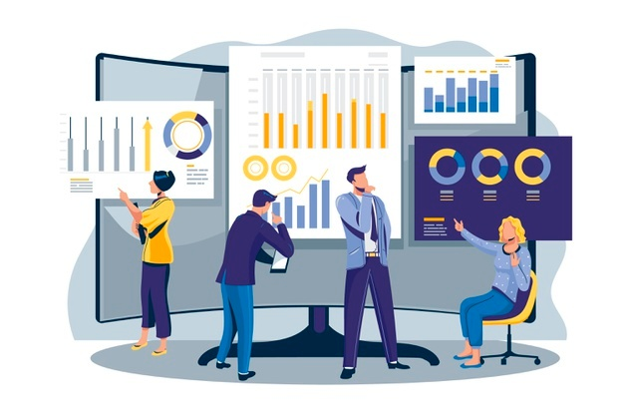
30 Days Python Master Class
Day1 : Python
Time: 6.00 PM IST
Free Registration

Slide 4
Python Master Class
Handbook

Slide 5
NANDHINI.S
Exp: 5 Yrs
Expert in
Python Developer on Machine Learning
Deep learning with computer vision
Matlab – Image Processing
Autonomous Car design using ROS with LIDAR
Language – Python , Java , HTML ,CSS.
Tools – ANACONDA NAVIGATOR, JUPYTER NOTEBOOK,
GOOGLE COLAB.
Graduation : BE – ECE | 2011

Slide 6
Pantech?
Educational Equipment Manufacturer
IoT, AI, Robotics,Autonomous Robot
Microprocessor/Microcontroller
DSP,VLSI, Embedded System
Power Electronics & Drives, Fuel Cell Trainer Kit
Renewable Energy Lab, Electric Vehicle Lab
Technical Training
DIY Project

Slide 7

What is Master Class ?
👍 This is the 30 Days Industrial Learning Activity.
👍 Its Online YouTube Live Class
👍 If you Invest 45 minutes daily, U will become Master in Data Science
👍 You will get FREE E-Certificate
Webinar Participation Certificate
“Learning is the beginning of wealth.
Searching & Learning is where the miracle process all begins.” …………….Jim Rohn

Slide 8
Our Vision
Help 10 Million Students to Learn the Technology in Easy Way

Slide 9

Associate Partner for this Master Class
https://apssdc.in/home/

Slide 10
What U will Learn from 30 Days Data Science & Analytics Master Class

Slide 11
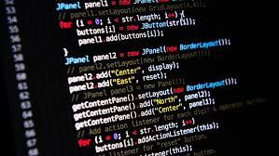
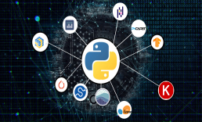
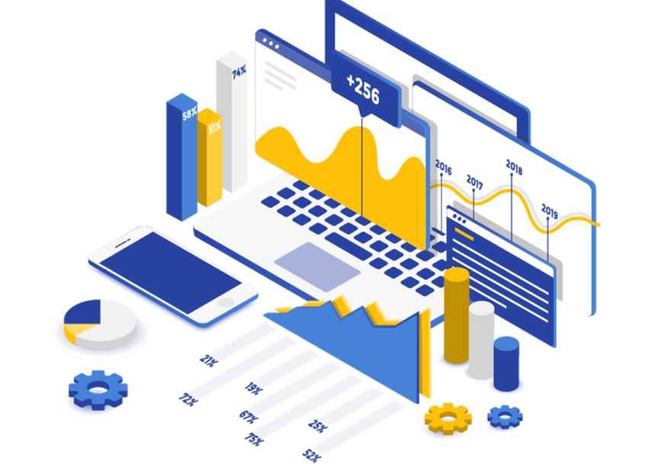

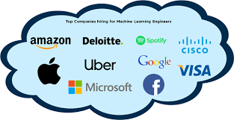
Python Learning Plan
01
02
03
04
05
Library
Python
Analytics
Analytics
Industry Project
Introduction To Python and Python Data Structures
Pandas
Numpy
MatplotLib
Cborn, SKLearn Lib
Collab
Distribution
Visualization
Aggregation
Statistics
Distribution Function
Project Building

Slide 12
Day wise Learning Plan
Day -1 : Introduction to Python
Day -2: Python – Tools|Syntaxes & Data Structures
Day -3: Python – Dictionaries,Date and Time
Day -4: Python – MySql
Day -5: Pandas library – Introduction
Day -6: Pandas library – Data Structures
Day -7: Numpy library – Introduction
Day -8: Numpy library – Array Manipulations, Mathematical Functions
Day -9: Matplotlib , Histogram Using Matplotlib | I/O With Numpy
Day -10: Matplotlib Library - Introduction , Pyplot API | Types Of Plots
Day -11: Seaborn Library
Day -12: SKLearn Library
Day -13: Python – Date and Time , Data Wrangling.
Day -14: Python – Data Cleansing
Day -15: Python – Word Tokenization , Stemming and Lammetization.

Slide 13
Day wise Learning Plan
Day -16: Python – Data Visualization
Day -17: Python – Statistical Analysis
Day -18: Python – Types Of Distribution
Day -19: Python – Correlation ,Chi-Square Test , Linear Regression
Day -20: Keras library – Introduction.
Day -21: Stock Price Prediction With Machine Learning LSTM RNN
Day -22: People’s behaviour in chat message using NLP NLP
Day -23: Gaming In Python
Day -24: Chatbot creation in Python NLP
Day -25: Electricity Price Prediction Using ML Random Forest Regressor
Day -26: Diamond Price Prediction Using Python Linear Regression
Day -27: Book Recommendation System KNN
Day -28: Image Classification Using CNN CNN
Day -29: Titanic Survival Analysis Using ML Logistic Regression
Day -30: Blockchain in Python

Slide 14
List of Projects for Demo in YouTube Live
Stock Price Prediction With Machine Learning
People’s behaviour in chat message using NLP
Gaming In Python
Chatbot creation in Python
Electricity Price Prediction Using ML
Diamond Price Prediction Using Python
Book Recommendation System
Image Classification Using CNN
Titanic Survival Analysis Using ML
Blockchain in Python
All Projects in Jupyter Notebook

Slide 15
What you will get from this Free 30 Days Master Class?
You can attend YouTube Live Class
Free E-Certificate ( WEBINAR PARTICIPATION CERTIFICATE)

Slide 16
How to mark your Attendance in YouTube Live Class?
Ans : During the Live Class, organizer will post Google Form link in Live Chat. The Participants should submit the from on daily basis. Minimum 25 Days Attendance is Required to get Free Master Class Participation Certificate.
Note : The Link will be available during the Live. From the LIVE Class date, the live video will get removed from the YouTube in 3 days.

Slide 17
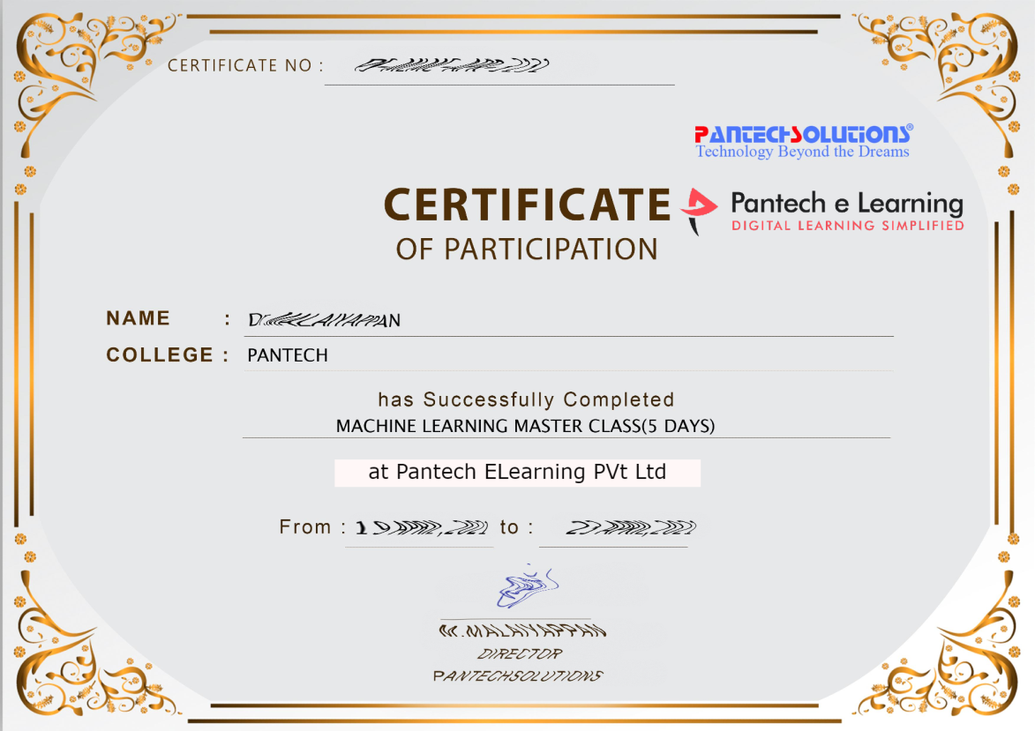

Sample Webinar Participation Certificate?

Slide 18
https://www.pantechelearning.com/data-science-master-class/
On Demand
You can get chance to apply 1 Month Internship on Data Science & Analytics Master Class

Slide 19
What is Internship????
Learn
Practice
Verify
Get Certified
Grow

Slide 20
Free Master Class DSA | 1 Month Internship on DSA
Master Class Participation Certificate | Internship Completion Certificate
Minimum 25 Class should attend YouTube Live | Recorded Class Link will be provided. – LMS Portal Access
YouTube Live Mandatory | Your Choice. You can attend Live or else You can watch Recorded Class in LMS Portal
All Projects Demo class in YouTube Live | Step by Step Video Explanation Content in LMS Portal
Access : 3 Days | VIP WhatsApp Group Support
 | You Can Download All PPTs
 | 4 Nos of Hackathon Class in Zoom Live. The Recording also will be provided
 | You Can Download All Project Files
 | Mentor will guide you to finish 10 Projects
 | Access : 60 Days

Slide 21
Pantech will make you to Create 10 Projects in Data Science & Analytics in 30 Days
Objective of this 30 Days Master Class

Slide 22
1 Month Internship in Data Science
INTERNSHIP E-Certificate(30Days Internship on Data Science Engineering)
Highly organized Video content
Download All Files
Download PPTs
Assignments
Flexible Time.
Access Period: 60Days from the date of payment

Slide 23
What You Will Get???
Complete Project Files
30 Days Learning Activity
Data Science Core Concepts
10 + Projects
Project PPT
Spatial Data Science For Covid-19 Disease Prediction
Parkinson’s Disease Prediction-XGBoost Classifier
House Price Prediction-Random Forest Regression
Customer Segmentation Using ML-K-Means Clustering
Home Loan Prediction-Decision Tree Classifier
Spam Classification-NLP
Hand Written Digit Recognition Using Python-CNN
Churn Prediction-Deep Learning
Crop Yield Prediction
Ground water level prediction
Video Class Access for 2 Months
Get chance to Enroll 1-Month Internship on demand

Slide 24
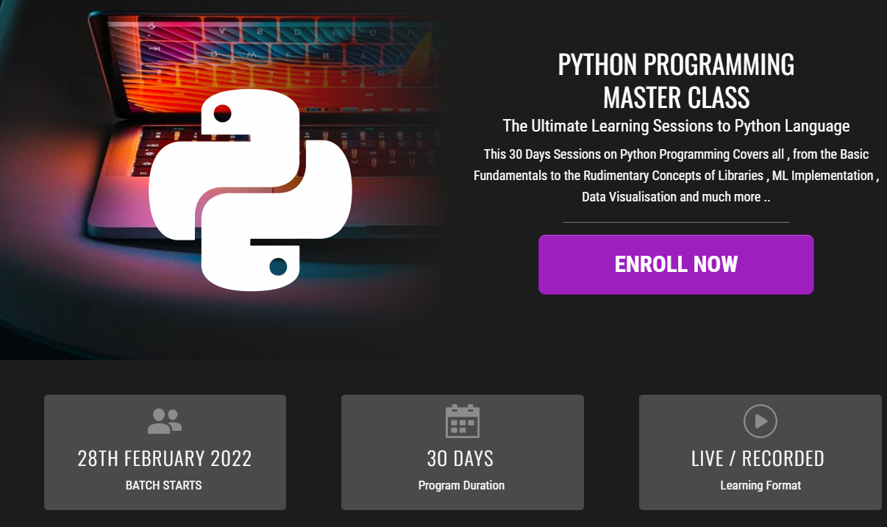
How to join in 1 month Internship
https://www.pantechelearning.com/pymc-internship/
Coupon Code: PYMC

Slide 25
Chatbots
Customer service and experience are the most important thing for any company.
It can help the companies improve their products and also keep the customers satisfied.
But interacting with every customer manually and resolving the problem can be a tedious task.
Chatbots help the companies in achieving the goal of smooth customer experience.

Slide 26
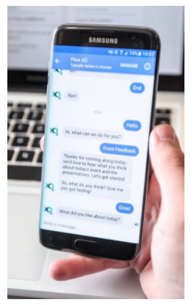
Chatbots

Slide 27
Chatbots
Today , many companies use chatbots for their apps and websites , which solves the basic queries of a customer.
It not only makes the process easier for the companies but also saves customers from the frustration of waiting to interact with customer call assistance.
Additionally , it can reduce the cost of reducing the call center representatives for the company.
Initially , chatbots were only used as a tool that solved customer’s queries , but today they have evolved into a personal companion.
From recommending products to getting feedback from customers , chatbots can do everything.

Slide 28
Chatbots
Survey Analysis:

Slide 29
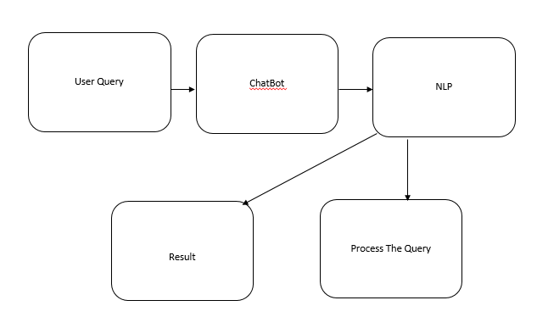
System Architecture Diagram

Slide 30
Understanding NLP
Natural language is about how humans communicate with each other.
NLP is a component of AI that deals with the interpretation and manipulation of human speech and text using software.
It enables the computer to understand the natural way of human communication by combining machine learning , deep learning and statistical models.
Due to the vast availability of big data , NLP is a rapidly advancing technology.
There are several ways to approach NLP , starting from statistical and machine learning to rule based and algorithmic approaches.

Slide 31
Understanding NLP
There are several tools provided to work in NLP.
Python programming language provides a NLTK and other open source libraries and educational resources for NLP programming.
Statistical analysis combines machine learning and deep learning models along with computer algorithms to extract and differentiate text and voice data and statistically provide meaning to all the elements.
NLP helps in a vast range of services starting form business analytics , speech recognition , social media etc.

Slide 32
Applications: Speech Recognition
Speech recognition is a technology that enables the computer to convert voice input data to machine readable format.
There are a lot of fields where speech recognition is used like , virtual assistants , adding speech – to – text , translating speech , sending emails , etc.
It is used in search engines where the user can voice out the name of their search requirements and get the required result.

Slide 33
Machine Translation
Machine translation (MT), process of translating one source language or text into another language, is one of the most important applications of NLP.
We can understand the process of machine translation with the help of the following flowchart −

Slide 34
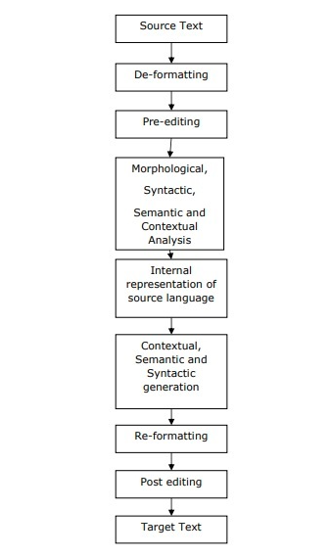
Machine Translation

Slide 35
Types of Machine Translation Systems
Bilingual MT System
Bilingual MT systems produce translations between two particular languages.
Multilingual MT System:
Multilingual MT systems produce translations between any pair of languages.
They may be either uni-directional or bi-directional in nature.

Slide 36
Types of Machine Translation Systems
Approaches to Machine Translation (MT)
Direct MT Approach
It is less popular but the oldest approach of MT. The systems that use this approach are capable of translating SL (source language) directly to TL (target language).
Such systems are bi-lingual and uni-directional in nature.
Interlingua Approach
The systems that use Interlingua approach translate SL to an intermediate language called Interlingua (IL) and then translate IL to TL.
The Interlingua approach can be understood with the help of the following MT pyramid −

Slide 37
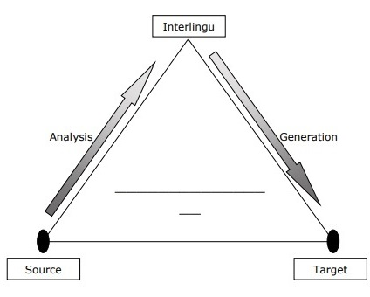
Types of Machine Translation Systems

Slide 38
Types of Machine Translation Systems
Transfer Approach
Three stages are involved with this approach.
In the first stage, source language (SL) texts are converted to abstract SL-oriented representations.
In the second stage, SL-oriented representations are converted into equivalent target language (TL)-oriented representations.

Slide 39
Types of Machine Translation Systems
In the third stage, the final text is generated.
Empirical MT Approach
This is an emerging approach for MT. Basically, it uses large amount of raw data in the form of parallel corpora. The raw data consists of the text and their translations. Analogybased, example-based, memory-based machine translation techniques use empirical MTapproach.

Slide 40
Applications Of NLP
Fighting Spam
One of the most common problems these days is unwanted emails. This makes Spam filters all the more important because it is the first line of defense against this problem.
Spam filtering system can be developed by using NLP functionality by considering the major false-positive and false-negative issues.

Slide 41
Applications Of NLP
Existing NLP models for spam filtering
Followings are some existing NLP models for spam filtering −
N-gram Modeling
An N-Gram model is an N-character slice of a longer string. In this model, N-grams of several different lengths are used simultaneously in processing and detecting spam emails.

Slide 42
Applications Of NLP
Word Stemming
Spammers, generators of spam emails, usually change one or more characters of attacking words in their spams so that they can breach content-based spam filters. That is why we can say that content-based filters are not useful if they cannot understand the meaning of the words or phrases in the email. In order to eliminate such issues in spam filtering, a rule-based word stemming technique, that can match words which look alike and sound alike, is developed.

Slide 43
Applications Of NLP
Bayesian Classification
This has now become a widely-used technology for spam filtering. The incidence of the words in an email is measured against its typical occurrence in a database of unsolicited (spam) and legitimate (ham) email messages in a statistical technique.

Slide 44
Applications Of NLP
Automatic Summarization
In this digital era, the most valuable thing is data, or you can say information. However, do we really get useful as well as the required amount of information? The answer is ‘NO’ because the information is overloaded and our access to knowledge and information far exceeds our capacity to understand it. We are in a serious need of automatic text summarization and information because the flood of information over internet is not going to stop.

Slide 45
Applications Of NLP
Text summarization may be defined as the technique to create short, accurate summary of longer text documents. Automatic text summarization will help us with relevant information in less time. Natural language processing (NLP) plays an important role in developing an automatic text summarization.

Slide 46
Applications Of NLP
Question-answering
Another main application of natural language processing (NLP) is question-answering. Search engines put the information of the world at our fingertips, but they are still lacking when it comes to answer the questions posted by human beings in their natural language. We have big tech companies like Google are also working in this direction.

Slide 47
Applications Of NLP
Question-answering is a Computer Science discipline within the fields of AI and NLP. It focuses on building systems that automatically answer questions posted by human beings in their natural language. A computer system that understands the natural language has the capability of a program system to translate the sentences written by humans into an internal representation so that the valid answers can be generated by the system. The exact answers can be generated by doing syntax and semantic analysis of the questions. Lexical gap, ambiguity and multilingualism are some of the challenges for NLP in building good question answering system.

Slide 48
Applications Of NLP
Sentiment Analysis
Another important application of natural language processing (NLP) is sentiment analysis. As the name suggests, sentiment analysis is used to identify the sentiments among several posts. It is also used to identify the sentiment where the emotions are not expressed explicitly. Companies are using sentiment analysis, an application of natural language processing (NLP) to identify the opinion and sentiment of their customers online.

Slide 49
Applications Of NLP
It will help companies to understand what their customers think about the products and services. Companies can judge their overall reputation from customer posts with the help of sentiment analysis. In this way, we can say that beyond determining simple polarity, sentiment analysis understands sentiments in context to help us better understand what is behind the expressed opinion.

